Slide 1
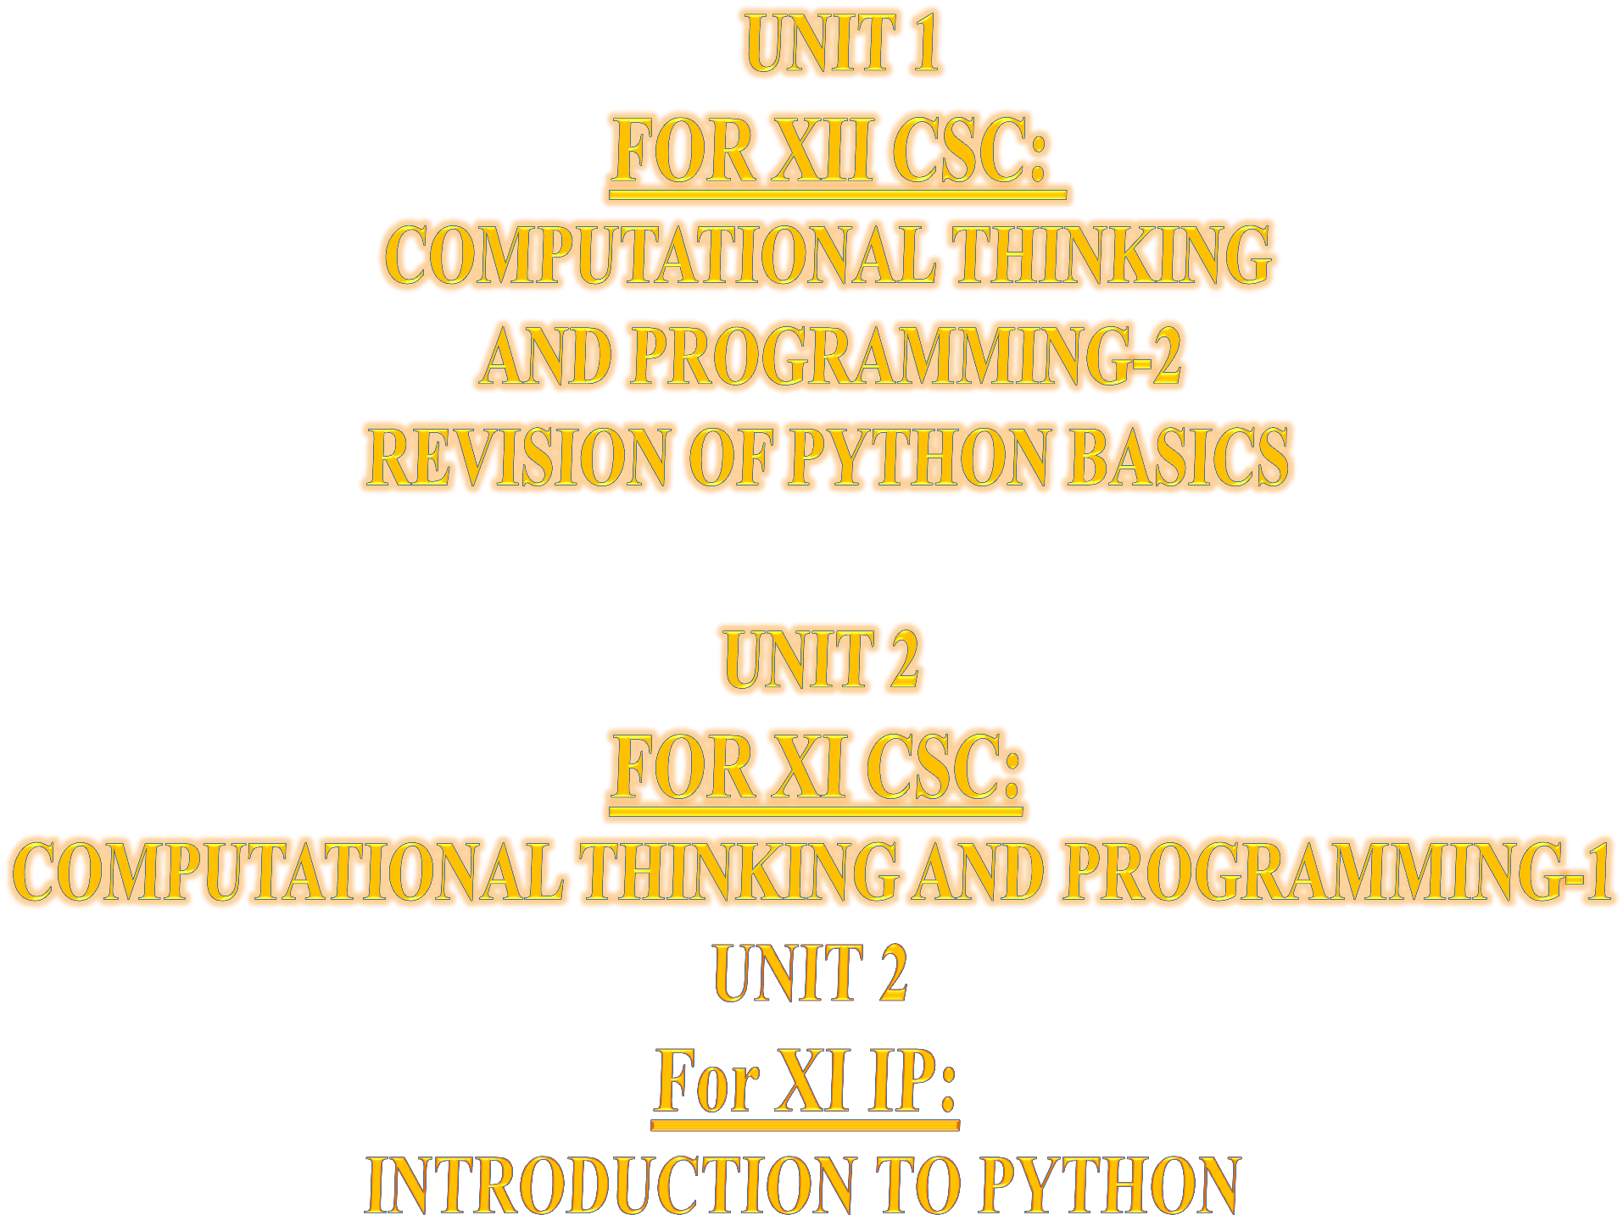

Slide 2






( Learning Outcomes ) ☺
CONTENTS
DICTIONARY in Python
XI CS 2020-21
Introduction :Definition, Creation, Accessing elements of a dictionary, add an item, modify an item in a dictionary;Traversal,
Functions/Methods – len(), dict(), keys(), values(), items(), get(), update(),
del(), del, clear(), fromkeys(), copy(), pop(), popitem(), setdefault(), max(), min(), sorted() ;
Suggested programs :
count the number of times each character appears in a given string using a
dictionary,
create a dictionary with employee no., names of employees, their salary
and display them.
XI IP 2020-21
Dictionary: concept of key-value pair, creating, initializing, traversing, updating
and deleting elements, dictionary methods and built-in functions

Slide 3


DICTIONARY
INTRODUCTION

Slide 4



DICTIONARY: Definition
CONTENTS
Let, us imagine that there are some set of lockers (/Dictionary), Each locker, with a unique KEY and some set of things (value) in it, is a Key:Value pair.
Dictionary data type is an unordered set of comma-separated key: value pairs, within { } , with the requirement that within a dictionary, no two keys can be the same (i.e. there are unique keys within a dictionary).
We can change dictionary elements.
It can contain values of mixed data
types.
Introduction :
Definition,
Creation,
Accessing elements, Add an item, Modify an item, Traversal,
Membership operator Functions/Methods : len(), dict(), keys(),
values(), items(), get(),
update(), del(), del, clear(),
fromkeys(), copy(), pop(), popitem(), setdefault(), max(), min(), sorted() copy();
Suggested programs
We can keep different things and change the items of the locker
Locker can hold any thing viz.
dresses, books, files etc.
Value
D = { 10 : ' CS', ' IP': 50 }
Key

Slide 5



DICTIONARY: Creation
CONTENTS
To create a Dictionary, we have to keep certain points in our mind:
A KEY can only be of IMMUTABLE data type viz.
Introduction :
Definition,
Creation,
Accessing elements, Add an item, Modify an item, Traversal,
Membership operator Functions/Methods : len(), dict(), keys(),
values(), items(), get(),
update(), del(), del,
clear(), fromkeys(),
copy(), pop(), popitem(), setdefault(), max(), min(), sorted() copy();
Suggested programs
String
Number
Tuple
VALUE can be of both MUTABLE or IMMUTABLE data type.
The curly brackets { } marks the beginning and end of a Dictionary.
Each entry (Key:Value) consists of a pair separated by colon :
that is , the key comes first and then after : its corresponding value.
The key:value pairs are separated by commas,
Internally, Dictionaries are indexed (arranged on the basis of keys).
Dictionaries are also known as Associative Arrays or
Mappings or Hashes
Creating empty dictionary with
dict() method
Creating empty dictionary by using empty curly braces {}

Slide 6
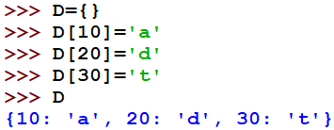







DICTIONARY: Creation contd..
Creating dictionary from empty Dictionary
Creating Dictionary by initializing directly. Writing key: value pair separated by comma , within curly braces {}
Creating Dictionary from Key and Value Pairs in the form of sequences
Creating Dictionary using aTUPLE OF LISTS containing [key,value] pair using dict() method
Creating Dictionary using a LIST OF LISTS containing
[key,value] pair using dict() method
Creating Dictionary using a TUPLE OF TUPLES
containing (key,value) pair using dict()
Creating Dictionary using a LIST OF TUPLES
containing (key,value) pair using dict() method
method
Creating Dictionary by zipping two Lists /or two Tuples containing Key and Values using zip( ) method and sending the zipped sequences of key and values to the dict() method as parameter.

Slide 7
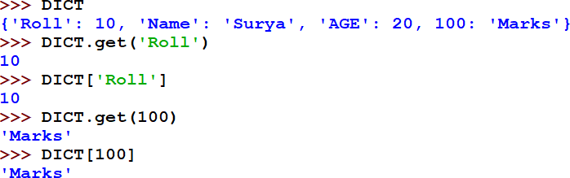
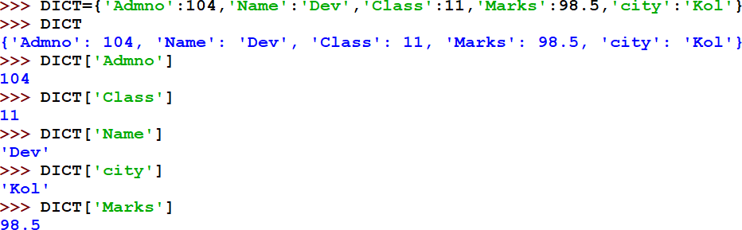
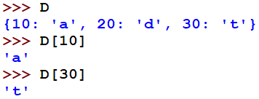
Accessing elements in DICTIONARY
CONTENTS
Introduction :
Definition, Creation,
Accessing elements,
Add an item, Modify an item, Traversal,
Membership operator
Functions/Methods
len(), dict(), keys(),
values(), items(), get(),
update(), del(), del,
clear(), fromkeys(),
copy(), pop(), popitem(), setdefault(), max(), min(), sorted() copy();
Suggested programs
Elements can be accessed using get() method with Dictionary or directly by writing the key inside [ ] with the Dictionary name

Slide 8
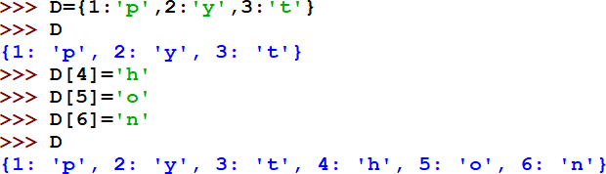
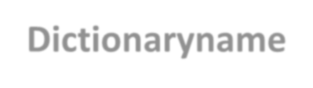


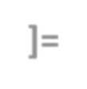

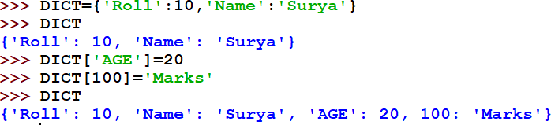
Add an item in a DICTIONARY
CONTENTS
 | Adding element by writing Dictionaryname[key]=value For eg. here, 4,5,6 are the keys and ‘h’,’o’,’n’ are the values being added by pairing respectively
Introduction :
Definition, Creation,
Accessing elements,
Add an item,
Modify an item, Traversal, Membership operator
Functions/Methods :
len(), dict(), keys(),
values(), items(), get(),
update(), del(), del, clear(),
fromkeys(), copy(), pop(), popitem(), setdefault(), max(), min(), sorted() copy();
Suggested programs :
Here, for key ‘AGE’ value is 20 and for the key 100 value is ‘Marks’

Slide 9
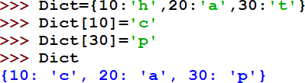
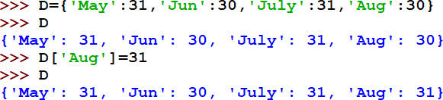
Modify an item in DICTIONARY
CONTENTS
Introduction :
Definition,
Creation,
Accessing elements, Add an item,
Modify an item,
Traversal, Membership operator
Functions/Methods :
len(), dict(), keys(),
values(), items(), get(),
update(), del(), del, clear(),
fromkeys(), copy(), pop(), popitem(), setdefault(), max(), min(), sorted() copy();
Suggested programs :
Here, Changes/modifications reflected in the encircled key:value pairs

Slide 10
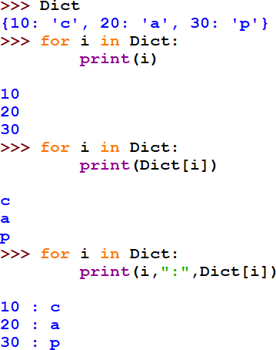
Traversal in a DICTIONARY
CONTENTS
Introduction :
Definition,
Creation,
Accessing elements, Add an item, Modify an item,
Traversal,
Membership operator Functions/Methods : len(), dict(), keys(),
values(), items(), get(),
update(), del(), del,
clear(), fromkeys(), copy(), pop(), popitem(), setdefault(), max(), min(), sorted() copy(); Suggested programs :
OUTPUT
OUTPUT
OUTPUT

Slide 11

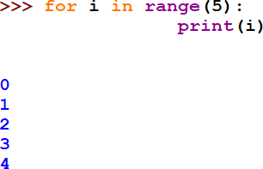
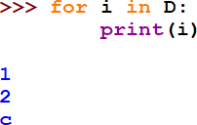
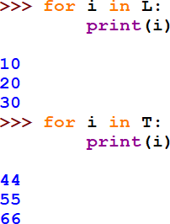
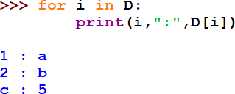
UNDERSTANDING TRAVERSAL
in Loop, List, Tuple, Dictionary
Traversal in a LOOP
Traversal in a LIST and TUPLE
Traversal in DICTIONARY
Here in Dictionary, i , variable of the loop picks the keys and D[i] picks the values of the Dictionary.
Here in List and Tuple, i , variable of the loop picks the values of the elements/items.
Here in Loops, i , variable of the loop picks the values of the range

Slide 12


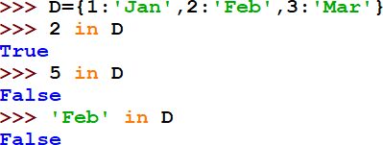
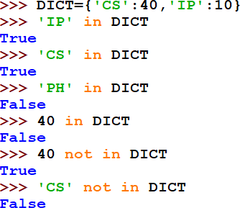
MEMBERSHIP OPERATOR in a DICTIONARY
CONTENTS
Membership operator IN, NOT IN tests for Existence of a Key in a Dictionary. Returns Boolean True or False
Introduction :
Definition, Creation,
Accessing elements, Add an item, Modify an item, Traversal,
Membership operator
Functions/Methods –
len(), dict(), keys(),
values(), items(), get(),
update(), del(), del,
clear(), fromkeys(), copy(), pop(), popitem(), setdefault(), max(), min(), sorted();
Suggested programs
OPERATOR | DESCRIPTION
in | Results to True , if it finds the KEY in the DICTIONARY, else it returns False
not in | Results to True , if it DOES NOT find the KEY in the DICTIONARY, else it returns False

Slide 13
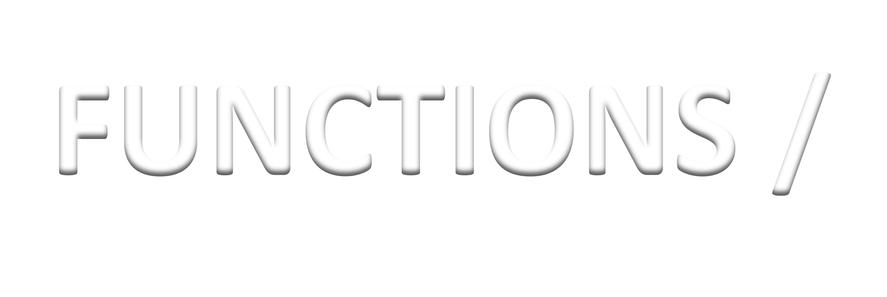


FUNCTIONS / METHODS DICTIONARY

Slide 14
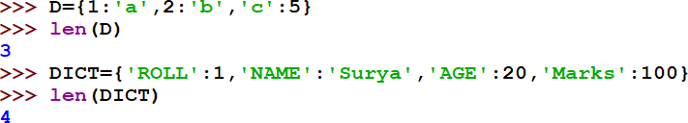
FUNCTIONS IN DICTIONARY: len()
CONTENTS
len( ) It returns length of the dictionary i.e. number of elements. Each element is a key:value pair.
Ex. One of the key:value pair
Introduction : Definition, Creation,
Accessing elements, Add an item, Modify an item, Traversal,
Membership operator
Functions/Methods:
len(), dict(), keys(),
values(), items(), get(),
update(), del(), del,
clear(), fromkeys(), copy(), pop(), popitem(), setdefault(), max(), min(), sorted() ;
Suggested programs :

Slide 15
FUNCTIONS IN DICTIONARY: dict()
dict( ) It is a built-in function that returns a dictionary object or simply creates a dictionary in Python. |  | Creating empty dictionary with dict() method
Creating Dictionary from Key and Value Pairs in the form of sequences
Creating Dictionary using aTUPLE OF LISTS containing [key,value] pair using dict() method
Creating Dictionary using a LIST OF LISTS containing
[key,value] pair using dict() method
Creating Dictionary using a TUPLE OF TUPLES
containing (key,value) pair using dict()
Creating Dictionary using a LIST OF TUPLES
containing (key,value) pair using dict() method
method
Creating Dictionary by zipping two Lists /or two Tuples containing Key and Values using zip( ) method and sending the zipped sequences of key and values to the dict() method as parameter.

Slide 16

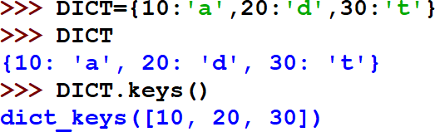
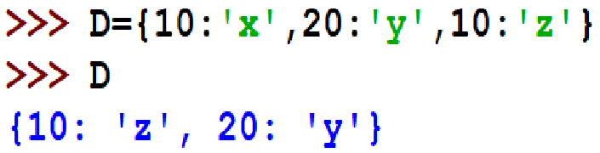
FUNCTIONS IN DICTIONARY: keys()
CONTENTS
keys( )
Returns a list containing the dictionary's keys
Introduction :
Definition, Creation,
Accessing elements, Add an item, Modify an item,
Traversal, Membership operator
Functions/Methods:
len(), dict(), keys(),
values(), items(), get(), update(),
del(), del, clear(), fromkeys(),
copy(), pop(), popitem(),
setdefault(), max(), min(), sorted() ;
Suggested programs
LIST of all the keys of
the key:value pairs
EXTRA FACTS
If a Dictionary is created with similar keys, then the key is considered only once and its Value is from the last occuring value of the key:value pair. Here, the key 10 has values ‘x’ and then ‘z’. So, the last occuring value ‘z’ is taken as its value.

Slide 17

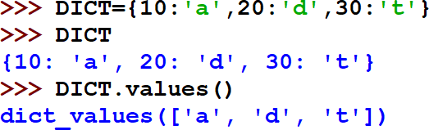
FUNCTIONS IN DICTIONARY: values()
CONTENTS
values( )
Returns a list of all the values in the dictionary
Introduction :
Definition, Creation,
Accessing elements, Add an item, Modify an item, Traversal,
Membership operator Functions/Methods: len(), dict(), keys(), values(), items(), get(), update(), del(), del,
clear(), fromkeys(), copy(), pop(), popitem(), setdefault(), max(), min(), sorted() ;
Suggested programs :
LIST of all the values of the key:value pair

Slide 18

FUNCTIONS IN DICTIONARY: items()
CONTENTS
items( )
Returns a list containing a tuple for each key value pair.
Introduction :
Definition, Creation,
Accessing elements, Add an item, Modify an item, Traversal,
Membership operator Functions/Methods: len(), dict(), keys(), values(), items(), get(), update(), del(),
del, clear(), fromkeys(),
copy(), pop(), popitem(), setdefault(), max(), min(), sorted() ; Suggested programs

Slide 19
FUNCTIONS IN DICTIONARY: get()
CONTENTS
get( )
Returns the value of the specified key
Introduction :
Definition, Creation,
Accessing elements, Add an item, Modify an item, Traversal,
Membership operator Functions/Methods: len(), dict(), keys(), values(), items(),
get(), update(),
del(), del, clear(),
fromkeys(), copy(),
pop(), popitem(),
setdefault(), max(),
min(), sorted() ;
Suggested programs :
Elements can be accessed using get() method with Dictionary or directly by writing the key inside [ ] with the Dictionary name

Slide 20
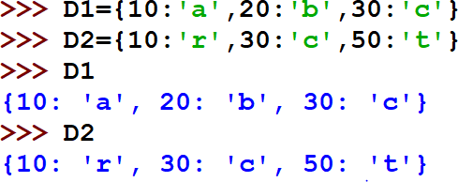
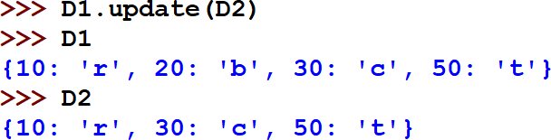
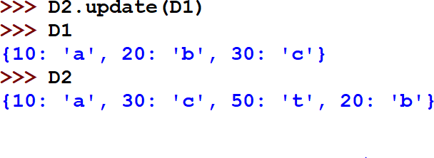
FUNCTIONS IN DICTIONARY: update()
CONTENTS
update( )
Updates the dictionary with the specified key-value pairs.
Introduction :
Definition, Creation,
Accessing elements, Add an item, Modify an item, Traversal,
Membership operator Functions/Methods: len(), dict(), keys(),
values(), items(), get(),
update(),
del(), del, clear(),
fromkeys(), copy(),
pop(), popitem(),
setdefault(), max(),
min(), sorted() ;
Suggested programs

Slide 21
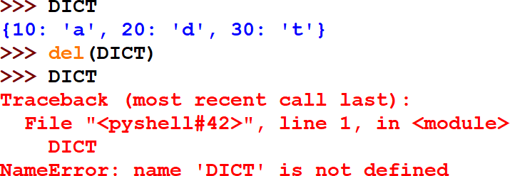
FUNCTIONS IN DICTIONARY: del()
CONTENTS
del( ) method
It removes an entire dictionary
Introduction :
Definition, Creation,
Accessing elements, Add an item, Modify an item, Traversal,
Membership operator Functions/Methods len(), dict(), keys(),
values(), items(), get(),
update(), del(), del,
clear(), fromkeys(),
copy(), pop(), popitem(), setdefault(), max(), min(),sorted(); Suggested programs

Slide 22
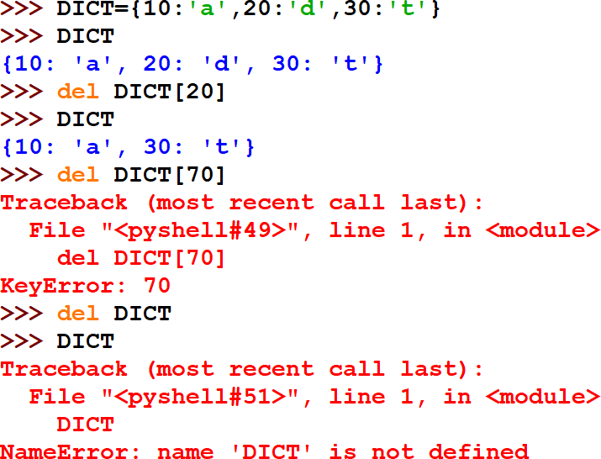
KEYWORD IN DICTIONARY: del
^{CONTENTS} del keyword
Introduction :
Definition, Creation,
Accessing elements, Add an item, Modify an item, Traversal,
Membership operator Functions/Methods len(), dict(), keys(),
values(), items(), get(),
update(), del(), del,
clear(), fromkeys(),
copy(), pop(), popitem(), setdefault(), max(), min(),sorted() ; Suggested programs
It removes a key-value pair from the dictionary based on the key.
If the key is present in the dictionary then it will delete the key and corresponding value from the dictionary.
But if the given key is not present in the dictionary then it will throw an error i.e. KeyError.

Slide 23
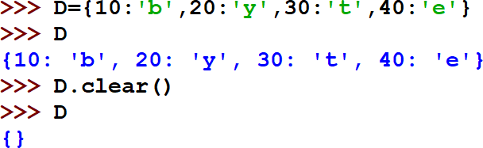
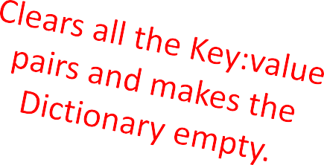
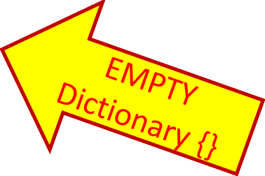
FUNCTIONS IN DICTIONARY: clear()
CONTENTS
Introduction :
Definition, Creation,
Accessing elements, Add an item, Modify an item, Traversal,
Membership operator Functions/Methods – len(), dict(), keys(), values(),
items(), get(), update(), del(), del, clear(), fromkeys(), copy(), pop(), popitem(), setdefault(), max(), min(), sorted() ; Suggested programs :
clear( )
Removes all the elements from the dictionary.

Slide 24
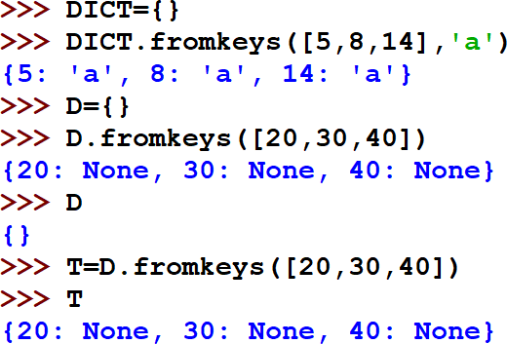
FUNCTIONS IN DICTIONARY: fromkeys()
CONTENTS
fromkeys( )
Returns a dictionary with the specified keys and value.
Syntax
dict.fromkeys(keys, value)
Introduction :
Definition,
Creation,
Accessing elements, Add an item, Modify an item, Traversal,
Membership operator Functions/Methods len(), dict(), keys(),
values(), items(), get(),
update(), del(), del,
clear(),
fromkeys(),
copy(), pop(), popitem(), setdefault(), max(),
min(), sorted();
Suggested programs
Parameter Values
Parameter Description
keys Required. An iterable specifying the keys of the new dictionary
value Optional. The value for all keys. Default value is None

Slide 25
FUNCTIONS IN DICTIONARY: copy()
CONTENTS | copy( )
Introduction : Definition, Creation, Accessing elements, Add an item, Modify an item, Traversal, Membership operator Functions/Methods len(), dict(), keys(), values(), items(), get(), update(), del(), del, clear(), fromkeys(), | Returns a shallow copy of the dictionary. (Shallow copy of the dictionary gets created where only keys are duplicated and same values are referenced by the two). If values are immutable, changes are NOT reflected in the copy. If values are mutable, changes are reflected in the copy. A new dictionary(copy) is created with the elements (key:value) pairs of the original (old) dictionary. No change in the original dictionary. Original dictionary remains the same. SYNTAX newdict=originaldict.copy()
copy(), pop(), popitem(), setdefault(), max(), min(), sorted() Suggested programs
There are two ways of copying a dictionary.
Using assignment operator (=)
Using copy() method

Slide 26
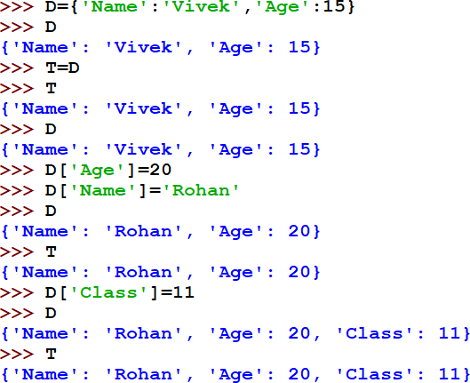
FUNCTIONS IN DICTIONARY: copy() contd.
1. Using assignment operator (=)
It will create the copy where the two labels will be referencing the same dictionary. Either changes in one dictionary will get reflected in the other.
Here, values of Dictionary D are assigned to a new label T (Dictionary)
Here, Changes are done in Dictionary D only.
Here, Changes get reflected in both the Dictionaries D and T.

Slide 27
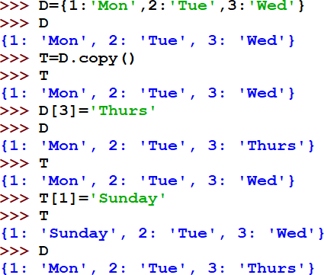
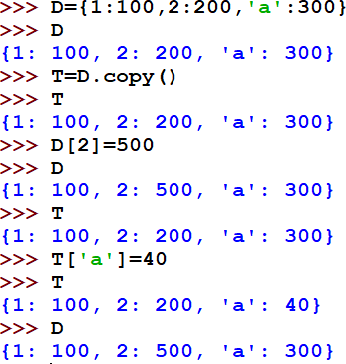
FUNCTIONS IN DICTIONARY: copy() contd.
2. Using copy() method a copy of keys is created with the new name and the values referenced are shared by the two copies. Again, there can be two scenarios on the basis of the VALUES being Immutable or Mutable.
Scenario (A): when VALUES are IMMUTABLE (such as Strings or numbers) Any changes in the copy created with copy() will not be reflected in the original dictionary as the copied set has own set of referencing keys. |  |  | Scenario (B): when VALUES are MUTABLE (such as Lists) keys will be referencing to the same Python list objects (memory addresses of the values won’t change) but lists being mutable can change
 | Here, in both the Scenarios, original Dictionary D is copied to a new label T (Dictionary) Here, in both scenarios, if there is any change done in any of the Dictionaries, it DOES NOT get reflected in the other Dictionary.

Slide 28
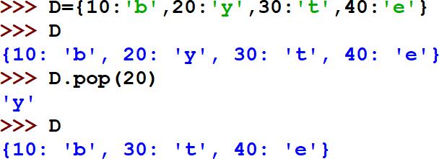
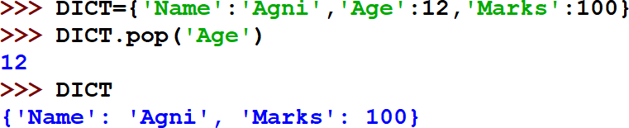
FUNCTIONS IN DICTIONARY: pop()
CONTENTS
pop( )
Removes the element with the specified key
SYNTAX
dict.pop(key)
Where key is the key of the key:value pair which is being deleted.
Introduction :
Definition, Creation,
Accessing elements, Add an item, Modify an item, Traversal,
Membership operator Functions/Methods – len(), dict(), keys(),
values(), items(), get(),
update(), del(), del,
clear(), fromkeys(),
copy(), pop(),
popitem(), setdefault(), max(), min(), sorted() ; Suggested programs :
pop() deletes the specified key:value
pair whose key if given as argument.
Here, age is the key and 12 is the
value which is being removed.

Slide 29
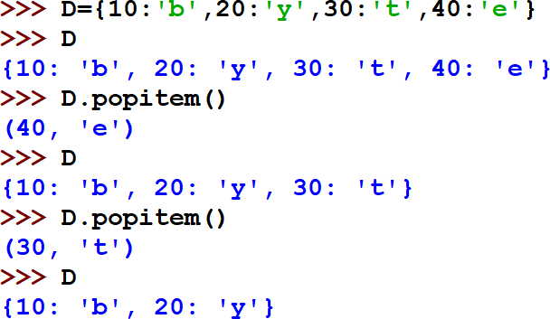
FUNCTIONS IN DICTIONARY: popitem()
CONTENTS
popitem( )
Removes the last inserted key:value pair.
Also, returns the key:value pair being deleted in the form of a tuple with the key and its value.
SYNTAX
Dict.popitem()
Introduction :
Definition, Creation,
Accessing elements, Add an item, Modify an item, Traversal,
Membership operator Functions/Methods – len(), dict(), keys(),
values(), items(), get(),
update(), del(), del,
clear(), fromkeys(), copy(), pop(), popitem(), setdefault(), max(), min(), sorted() ;
Suggested programs :
popitem() deletes the last key:value pair occurring in the Dictionary. Also, returns the key,value pair being deleted in a tuple form.

Slide 30
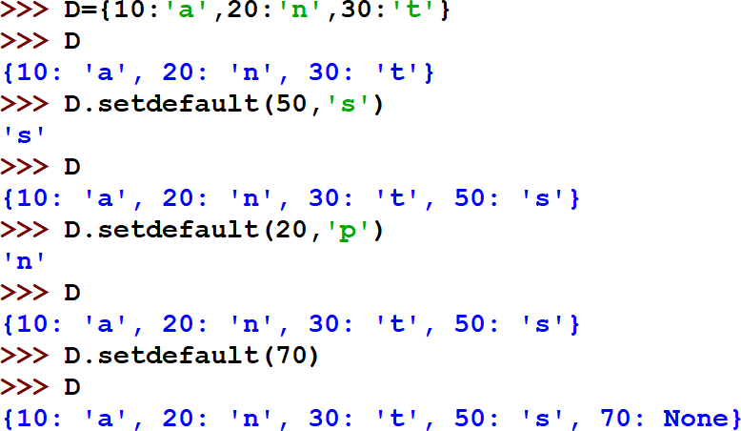
FUNCTIONS IN DICTIONARY: setdefault()
CONTENTS
setdefault( ) Returns the value of the specified key. If the key does
not exist: insert the key, with the specified value.
Syntax
dictionary.setdefault(keyname, value)
Introduction :
Definition, Creation,
Accessing elements, Add an item, Modify an item, Traversal,
Membership operator Functions/Methods len(), dict(), keys(),
values(), items(), get(),
update(), del(), del,
clear(), fromkeys(),
copy(), pop(),
popitem(),
setdefault(),
max(), min(), sorted() ; Suggested programs
keyname | Required. The keyname of the item you want to return the value from
value | Optional. If the key exist, this parameter has no effect. If the key does not exist, this value becomes the key's value Default value None
Here, key 50 doesn’t exist, so, key
50 and its value ‘s’ has been taken.
Here, key 20 exists, so, key 20 and
its old value ‘n’ has been taken.
Here, new key 70 doesn’t exist, and no value is provided. So, value None has been taken.

Slide 31


FUNCTIONS IN DICTIONARY: max()
CONTENTS
max( )
To find key with Maximum value in Dictionary
Introduction :
Definition,
Creation,
Accessing elements, Add an item, Modify an item, Traversal,
Membership operator Functions/Methods len(), dict(), keys(),
values(), items(), get(),
update(), del(), del,
clear(), fromkeys(),
copy(), pop(), popitem(), setdefault(), max(), min(), sorted() ;
Suggested programs
Here, Month is the name of the dictionary. The keys are numeric.
Here, D is the dictionary. The keys are characters (alphabets).
So, they are checked as per the ASCII rule.
In ASCII, A=65,B=66….so on a=97,b=98,……….so on

Slide 32


FUNCTIONS IN DICTIONARY: min()
CONTENTS
min( )
To find key with Minimum value in Dictionary
Introduction :
Definition, Creation,
Accessing elements, Add an item, Modify an item, Traversal,
Membership operator Functions/Methods – len(), dict(), keys(),
values(), items(), get(),
update(), del(), del, clear(),
fromkeys(), copy(), pop(), popitem(), setdefault(), max(), min(),sorted() ; Suggested programs :
Here, Month is the name of the dictionary. The keys are numeric.
Here, D is the dictionary. The keys are characters (alphabets).
So, they are checked as per the ASCII rule.
In ASCII, A=65,B=66….so on a=97,b=98,……….so on

Slide 33
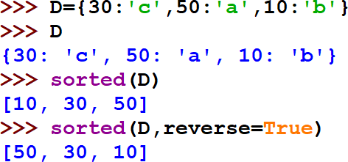

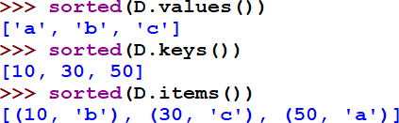
FUNCTIONS IN DICTIONARY: sorted()
CONTENTS
sorted( )
It returns the list of keys sorted in ascending order by default.
For the list of keys in descending order, reverse=True
Introduction :
Definition, Creation,
Accessing elements, Add an item, Modify an item, Traversal,
Membership operator Functions/Methods – len(), dict(), keys(),
values(), items(), get(),
update(), del(), del,
clear(), fromkeys(),
copy(), pop(), popitem(),
setdefault(), max(), min(), sorted() ; Suggested programs :

Slide 34


NESTED DICTIONARY

Slide 35
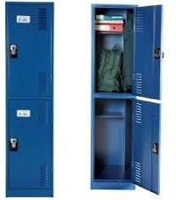
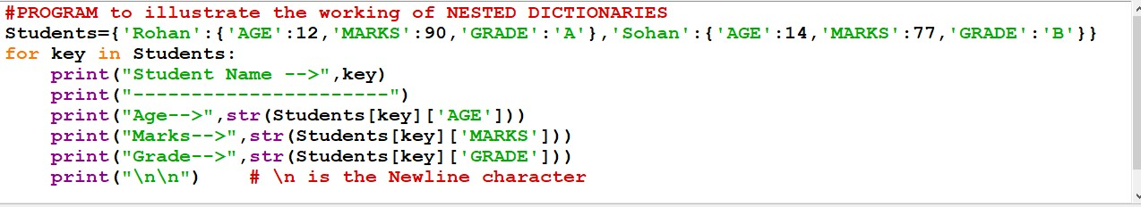
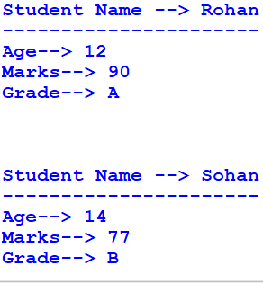

NESTED DICTIONARIES
Dictionary within a Dictionary is called as Nested Dictionary.
  The outer Dictionary is known as ENCLOSING Dictionary.
  The inner Dictionary is known as the NESTED dictionary.
    We can give a DICTIONARY as a VALUE to another Dictionary.
We CANNOT give a DICTIONARY as a KEY to another
Dictionary as Dictionaries are mutable..
OUTPUT

Slide 36




SOME PROGRAMS IN DICTIONARY

Slide 37
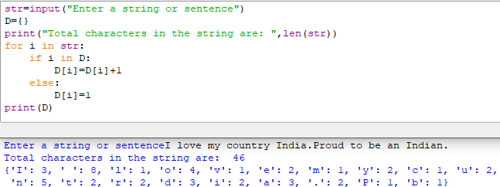

PROGRAM 1:
Count the number of times a character/digit appears in a given string using a dictionary
OUTPUT

Slide 38
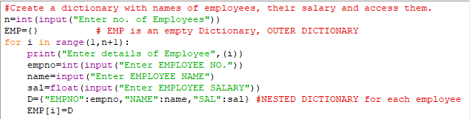
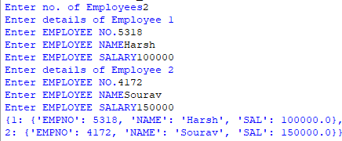

PROGRAM 2:
Create a dictionary with employee numbers, names of employees, their salary and display them.
OUTPUT

Slide 39
Create a dictionary whose keys are month names and whose values are the same number of days in the corresponding month:
1) ask the user to enter a month name and use the dictionary to tell them how many days are in the month.
2) print out all of the keys in alphabetical order.
3) print out all of the months with 31 days.
4) print out the elements sorted by the number of days in each month.

Slide 40
Bibliograhy and References
Google
Wikipedia
XI Computer Science , By Sumita Arora, Dhanpat Rai Publication 2020 Edition
XI Informatics Practices , By Sumita Arora, Dhanpat Rai Publication 2020 Edition

Slide 41


Slide 42








Programming is an ART….
Add your colours to it and make your own

